Slide 1
Exploring Hodgkin-Huxley As a Space Dependent Model
Rebecca Elise Berge, Dan Huang
Virginia Commonwealth University
7 May 2018

Slide 2
Content
Introduction
What We Know
What We Don’t Know
Methods
Ohm’s Law
Hodgkin-Huxley Model
Results
Conclusions

Slide 3
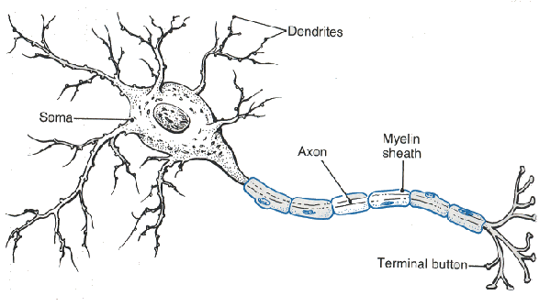
What We Know
The Hodgkin-Huxley Model is derived from the cable equation and Ohm’s Law as an ODE
We simulated The Hodgkin-Huxley Model (hh.m) in class looking at Current effects on Action Potential
The original Hodgkin-Huxley model: the membrane of the squid giant axon contains three type of ion channels.
Potassium Activation Channel (n)
Sodium Activation Channel (m)
Sodium Inactivation Channel (h)
Hodgkin-Huxley is a Temporal Model

Slide 4

What We Don’t Know
How to implement Hodgkin-Huxley as a nonlinear PDE
Effects on Action Potentials traveling down an axon dependent on Space
Effects of Channel Noise on Action Potentials
Effects on Noise of Changing the Number of Voltage-Gated Ion Channels

Slide 5
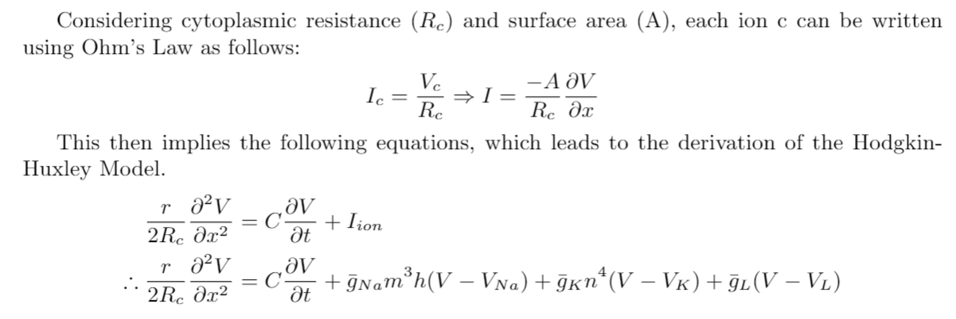
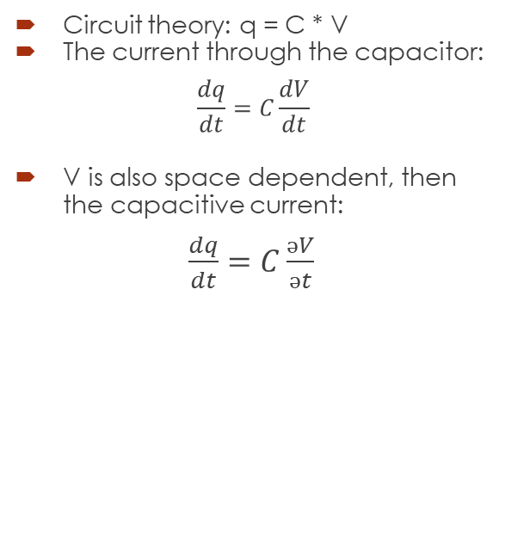
Ohm’s Law
Circuit theory: q = C * V
The current through the capacitor:
$$\frac{dq}{dt}=C\frac{dV}{dt}$$
V is also space dependent, then the capacitive current:
$\frac{dq}{dt}=C\frac{əV}{ət}$

Slide 6
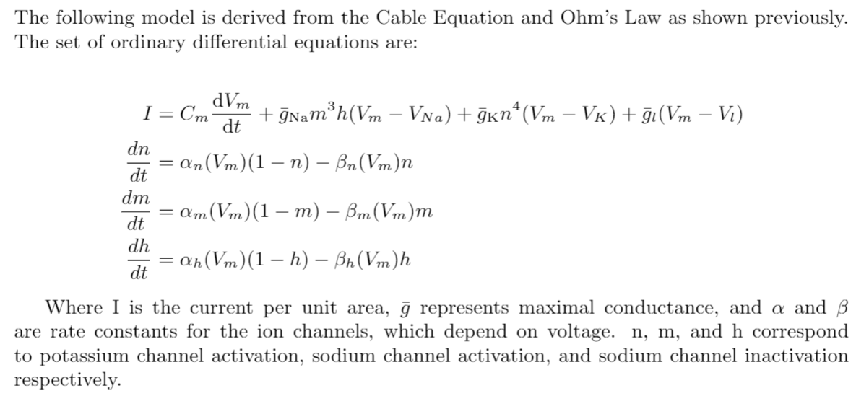
Hodgkin-Huxley Model
Original Model

Slide 7
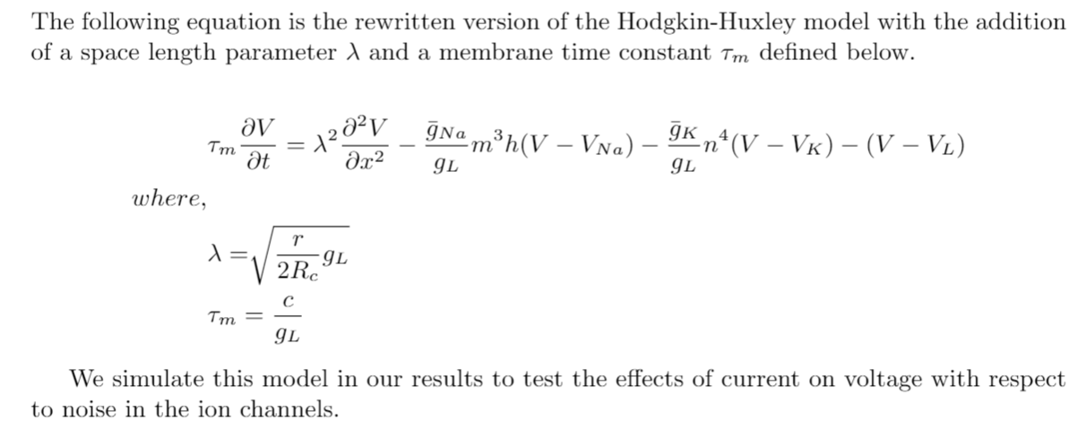
Hodgkin-Huxley Model
Diffusion Model

Slide 8
Results

Slide 9
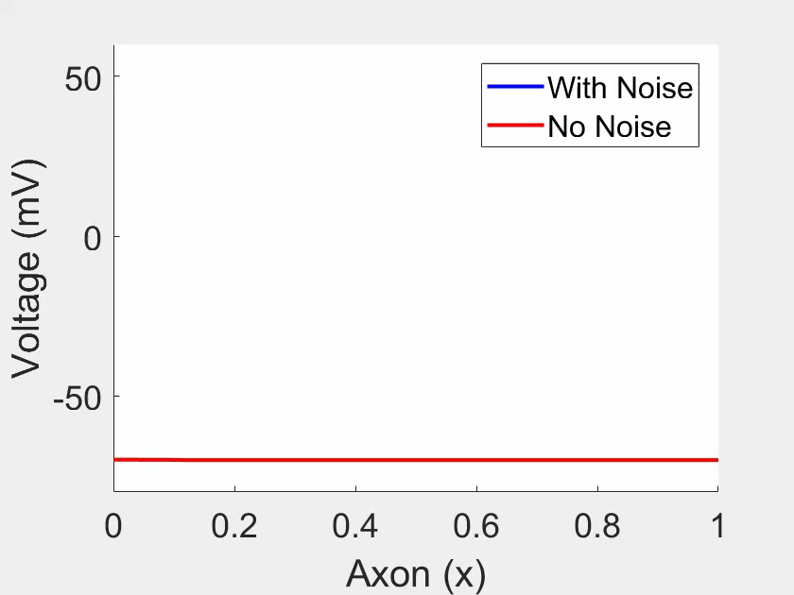
Current (I_app) = 10 units

Slide 10

Current (I_app) = 20 units

Slide 11
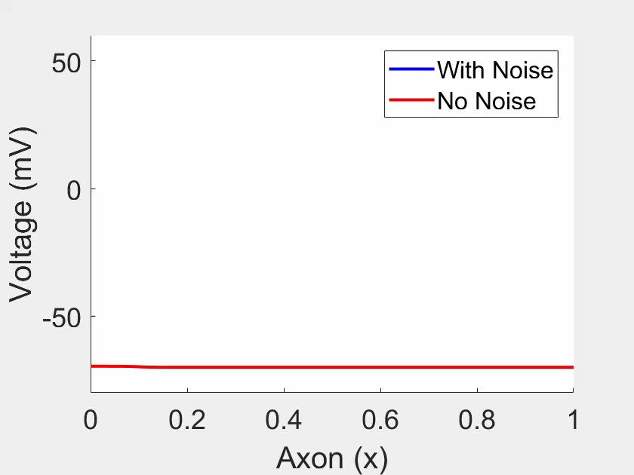
Current (I_app) = 40 units

Slide 12

Current (I_app) = 60 units

Slide 13

Current (I_app) = 100 units

Slide 14
Five Voltage-Gated Ion Channels
Current = 20
Current = 60

Slide 15
Fifty Voltage-Gated Ion Channels
Current = 20
Current = 60

Slide 16
500 Voltage-Gated Ion Channels
Current = 20
Current = 60

Slide 17
Conclusions

Slide 18
Change in Current
When different current levels are injected:
I_app=10, different smoothness, no spikes present, slow pace
I_app=20, spike occurs, noise deviates slightly, quickened pace
I_app=40, spike occurs, small change by noise, faster pace
I_app=60, periodic spiking occurs without noise and is faster than with noise
I_app=100, both have periodic spiking, speed of the waves increase
Summary:
Before Spiking: enough current must be injected to cause a spike
Before Periodic Spiking: with or without noise, the waves are similar.
During Periodic Spiking (60): the speed of the wave without noise is faster than that with noise
After Periodic Spiking (100): the speed of the wave with noise is faster than without noise
Disadvantages: Minimum Current, Random Choices, Exaggerated Levels

Slide 19
Change in Ion Channels
Five Ion Channels
Spiking occurs with noise and periodic spiking occurs without noise at current level 20; current level 60 also shows more noise causing periodic spiking ; with respect to speed of the waves, the wave with noise is faster than that without noise at current levels 20 and 60.
Fifty Ion Channels
There are more spikes with noise at current level 20; both have periodic spiking at current level 60; in terms of speed of the waves, the wave with noise is faster than that without noise at current level 20 and 60. The increase in ion channels shows less noise present and a smoother curve.
Five Hundred Channels
The noise level decreases immensely and the smoothness of the curves are improved. The waves with noise are still faster than those without noise.
Disadvantages: Exaggerated Numbers, Variety of Current Levels, Variety of Number of Ion Channels

Slide 20
Thank You

